Slide 1
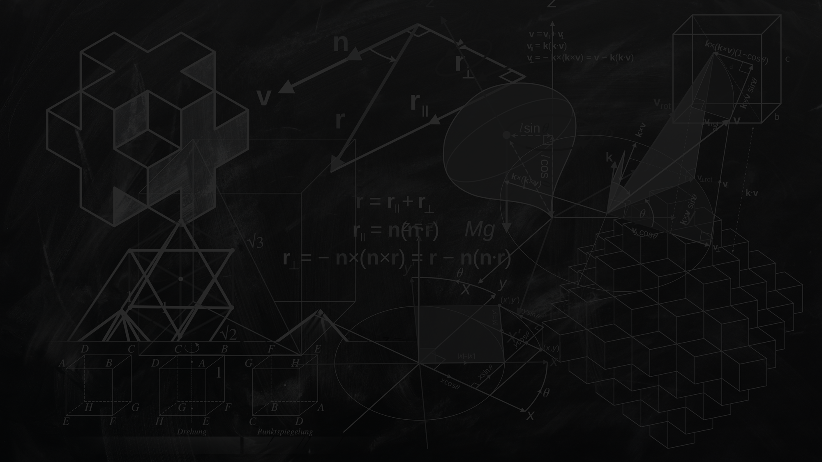

Pneumonia detection by Transfer learning and CNN
Team Member N#
1 Ruixuan Wang N19997322
2 Wengying Wen N16116736
3 JiongHui Chen N19050877
4 Jinjin Ma N15491779

Slide 2
Background
The risk of pneumonia is immense for many, especially in developing nations where people rely on polluting forms of energy.
The problem can be further aggravated due to the dearth of medical resources and personnel.
One of the most urgent needs in combatting pneumonia is a cost-effective manner of diagnosing X-ray images.

Slide 3
Abstract
This project proposes a machine learning model using convolutional neural network to classify and detect the presence of pneumonia from a collection of chest X-ray image samples.
This model could help mitigate the reliability and interpretability challenges often faced when dealing with medical imagery.
It is difficult to obtain a large amount of pneumonia dataset for this classification task.
Therefore, we deployed Structure Correcting Adversarial Network to segment lung fields relied on a pre-trained model to improve the validation and classification accuracy of the CNN model and achieved remarkable validation accuracy.

Slide 4
GANs-SCAN
In medical field, always lacking of labeled training data. In this context, generative modeling can still perform well. The adversarial training concept behind GANs theoretically eliminates the need to model explicit pixelwise objective functions by learning a rich similarity metric to tell real and fake data apart. This allows to optimize for concepts in images beyond the pixel-level, leading to more realistic results.
Dai[1] et al. propose a GAN based solution (SCAN) to enhance global consistency of segmentation and extract contours of the heart and left/right lungs. It is a fully connected network with a VGG down-sampling path and residual blocks to use much fewer feature maps in the generator. And we use this is our preprocessing step.

Slide 5
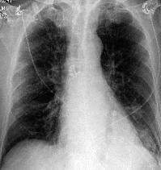
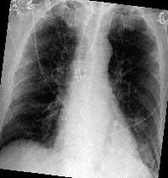
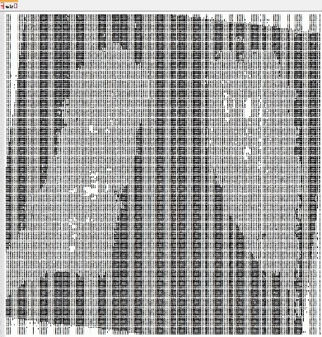
Preprocess
Data Augmentation
Due to lack of data
Increase sample size
We can expand our dataset three times by rotation.
Graph process
Decrease unnecessary factors on graphs
Increase emphasis on lung

Slide 6
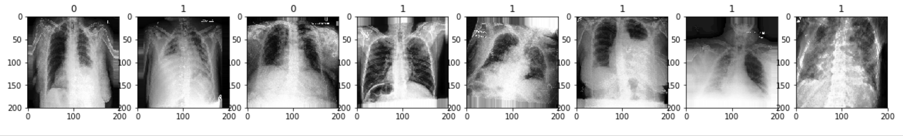
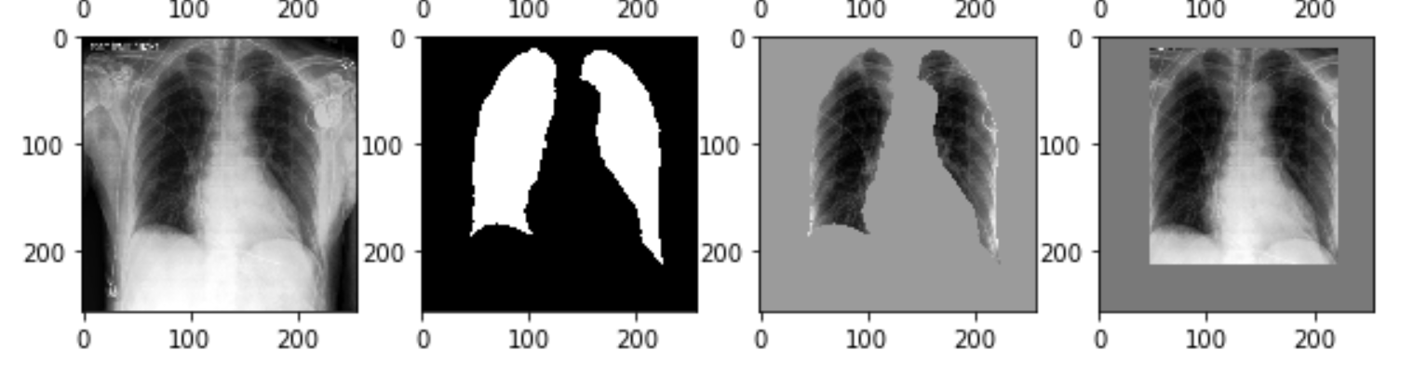
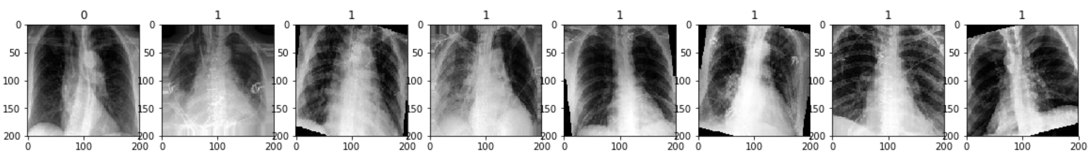
Construction
Preprocessed data
Original Data
Pretrained model
Segmentation
Augmentation
More layers
Test accuracy with model
Data processed

Slide 7
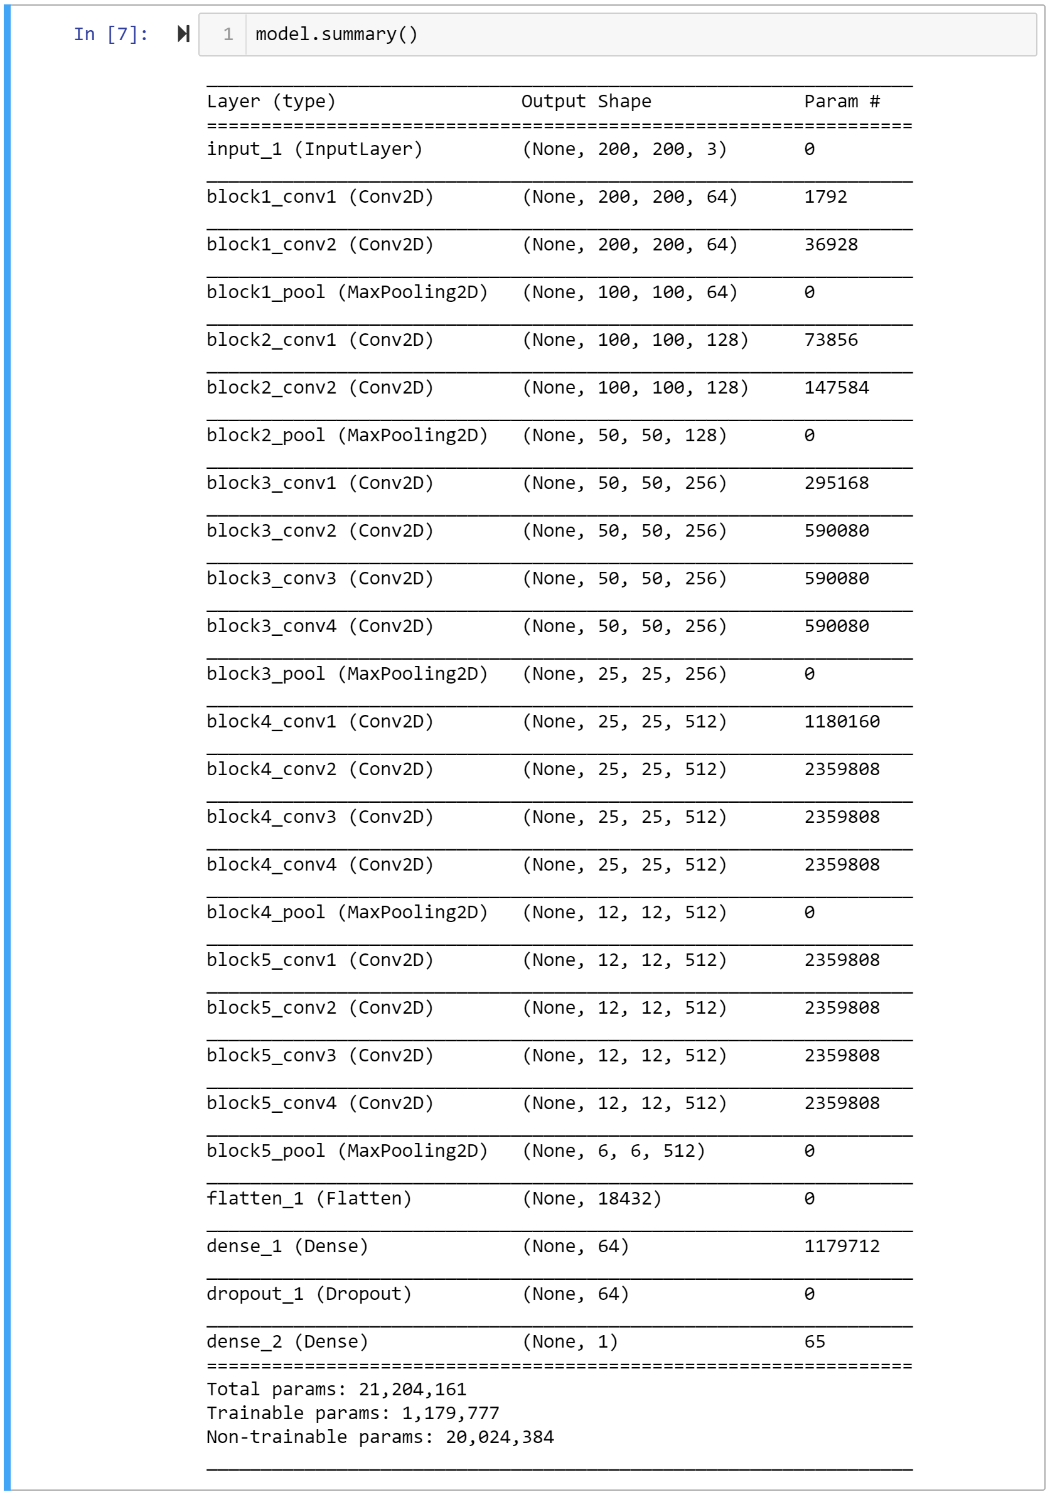
Construction
Preprocessed data
Model | T-1 ACC | T-5 ACC | Depth
VGG16 | 0.715 | 0.901 | 23
VGG19 | 0.727 | 0.910 | 26
Pretrained model
Compared with VGG16:
Higher accuracy
More depth and parameters
More layers
Test accuracy with model

Slide 8
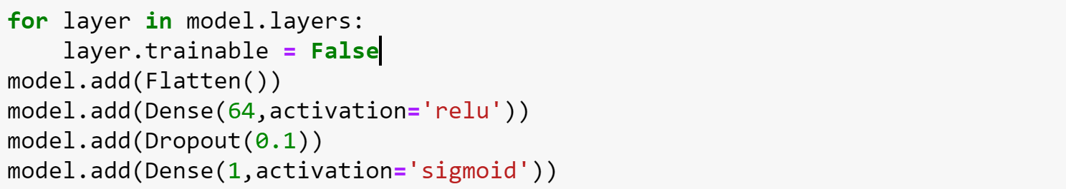
Construction
Preprocessed data
Flatten layer:
Transfer the high dimension data calculated from convolution layer in to one dimension to fit the format in full connected layer.
Dense layer:
Set 64 hidden units to simulate various features of the target, using activation function ‘relu’ and ‘sigmoid’.
Dropout layer:
In this case we drop 90% percent of coefficients to avoid overfitting.
Pretrained model
More layers
Test accuracy with model

Slide 9
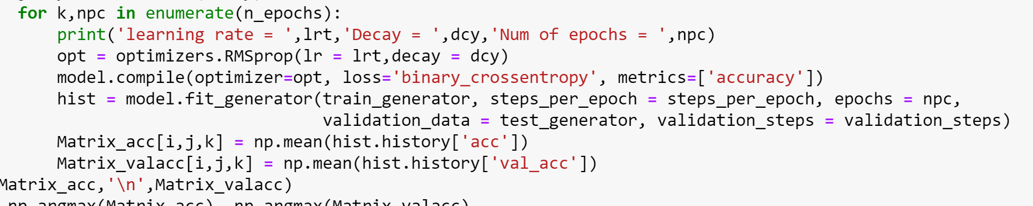
Construction
Preprocessed data
Totally, after data augmentation, We get
50031 images for training
12516 images for testing.
Both in two classes
For parameter selection, we can build a GridSearch function to get the best fitting parameter in this problem.
We set three learning rates, three decays and three number of epochs for this grid searching.
Pretrained model
More layers
Test accuracy with model

Slide 10
Parameters
Epoch=5 |  | Learning rate
 |  | 1e-3 | 1e-4 | 1e-5
Decay | 1e-3 | 77.71% | 77.91% | 77.73%
 | 1e-4 | 77.78% | 79.03% | 78.19%
 | 1e-5 | 75.63% | 77.78% | 78.68%
Epoch=10 |  | Learning rate
 |  | 1e-3 | 1e-4 | 1e-5
Decay | 1e-3 | 77.37% | 77.17% | 77.43%
 | 1e-4 | 77.51% | 76.08% | 76.73%
 | 1e-5 | 78.71% | 78.36% | 76.36%
Epoch=15 |  | Learning rate
 |  | 1e-3 | 1e-4 | 1e-5
Decay | 1e-3 | 77.86% | 77.45% | 77.26%
 | 1e-4 | 78.08% | 77.50% | 77.81%
 | 1e-5 | 77.17% | 77.28% | 77.45%

Slide 11
Evaluation
After grid searching, we use the group of parameter with the highest accuracy.
Learning rate = 0.0001, decay = 0.0001 and Epochs = 5
Then we use F1-score to evaluate this model.
With an average F1-score of 0.8729 and average val-F1-score of 0.08773 , our model exceeds average radiologist performance on the F1 metric.

Slide 12
More thoughts
The main challenge in medical imaging often classification or segmentation is presented as a binary task: normal versus abnormal and object versus background. The problem is often a gross simplification as both classes can be highly heterogeneous
Another data-related challenge is class imbalance. In medical imaging, images for the abnormal class might be challenging to find. In medical image analysis useful information is not just contained within the images themselves. Physicians often leverage a wealth of data on patient history, age, demographics and others to arrive at better decisions.
Finally, deep learning methods have often been described as ‘black boxes’. Especially in medicine, where accountability is important and can have serious legal consequences, it is often not enough to have a good prediction system.

Slide 14
Reference
Dai W, Dong N, Wang Z, et al. SCAN: Structure correcting adversarial network for organ segmentation in chest X-rays[M]//Deep Learning in Medical Image Analysis and Multimodal Learning for Clinical Decision Support. Springer, Cham, 2018: 263-273.
Litjens G, Kooi T, Bejnordi B E, et al. A survey on deep learning in medical image analysis[J]. Medical image analysis, 2017, 42: 60-88.
Stephen O, Sain M, Maduh U J, et al. An Efficient Deep Learning Approach to Pneumonia Classification in Healthcare[J]. Journal of Healthcare Engineering, 2019.

